Slide 1
California’s Hub and Spoke System Perspectives on Integrated Care for the Opioid Epidemic
Gloria M. Miele, Ph.D., UCLA Integrated Substance Abuse Programs
Joe Sepulveda, MD, Family Health Centers of San Diego
Frances Southwick, MD, CommuniCare Health Centers, Davis, CA
Alex Novek, Consumer
Integrating Substance Use, Mental Health, and
Primary Care Services: 15th Statewide Conference
Los Angeles, CA
October 24-25, 2018

Slide 2
Agenda
Update on California’s Hub and Spoke MAT expansion project
Provider and consumer perspectives on medication-assisted treatment
Joe Sepulveda, MD, Family Health Centers of San Diego
Frances Southwick, MD, CommuniCare Health Centers, Davis, CA
Alex Novek, Consumer
Questions and discussion

Slide 3
California’s Hub & Spoke System
California’s State Targeted Response to the Opioid Epidemic
Based on the Vermont Hub & Spoke Model
Goal to increase access to Medication-Assisted Treatment (MAT) throughout the state
Harnesses the strengths of specialty methadone Opioid Treatment Programs (OTP) and skills of physicians and advanced practice clinicians who prescribe buprenorphine in office-based settings
Notes:
NTPs are the only entities that are allowed by federal law to provide methadone treatment for an OUD.

Slide 4
Hubs
NTPs act as “Hubs,” and serve as the regional consultants and subject matter experts on opioid dependence and treatment
Provide care to clinically complex buprenorphine patients and those whose treatment plan includes methadone
Manage buprenorphine inductions
Support Spokes that need clinical or programmatic advice

Slide 5
Spokes
Spokes may be (1) a federally waivered prescriber, or (2) one or more federally waivered prescribers and a MAT team.
Provide ongoing care for patients with milder SUD (managing induction and maintenance) and for stable patients on transfer from a Hub
Monitor adherence to treatment
Coordinate access to recovery supports
Provide counseling
FQHCs are ideal

Slide 6
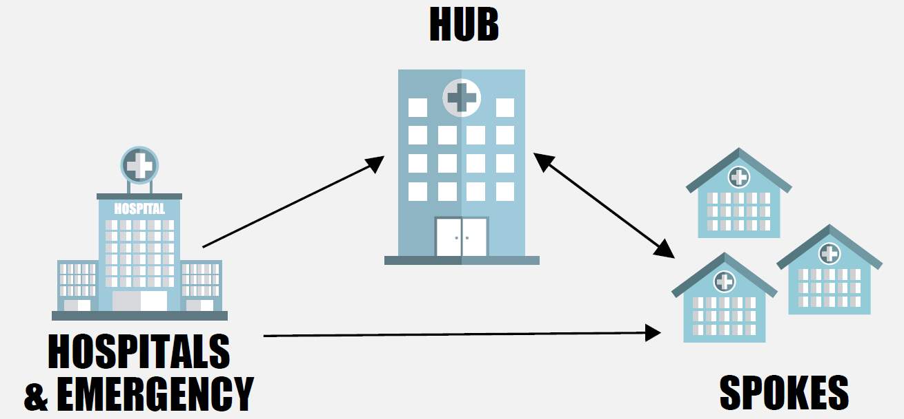
Hub and Spoke Interaction
Patients move between the Hub and Spoke based on clinical severity and need

Slide 7
System Expansion

Slide 8
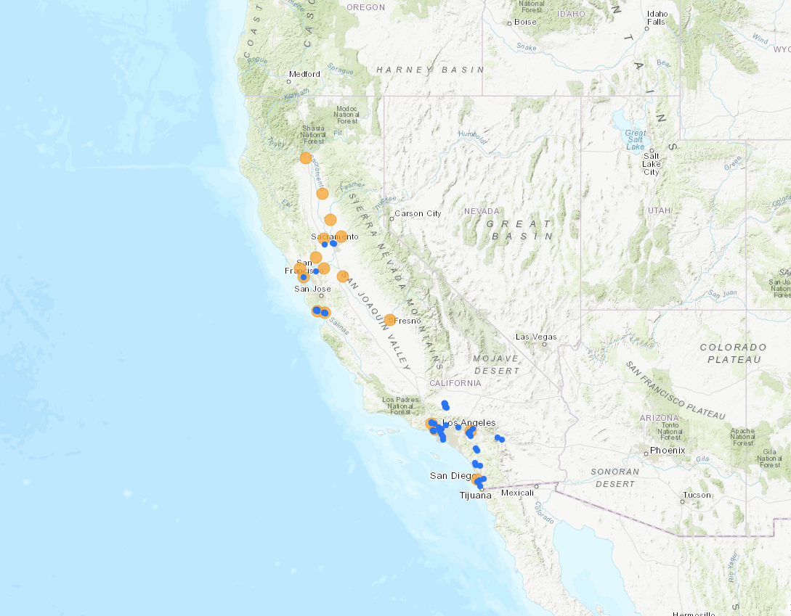
Aug – Nov 2017

Slide 9
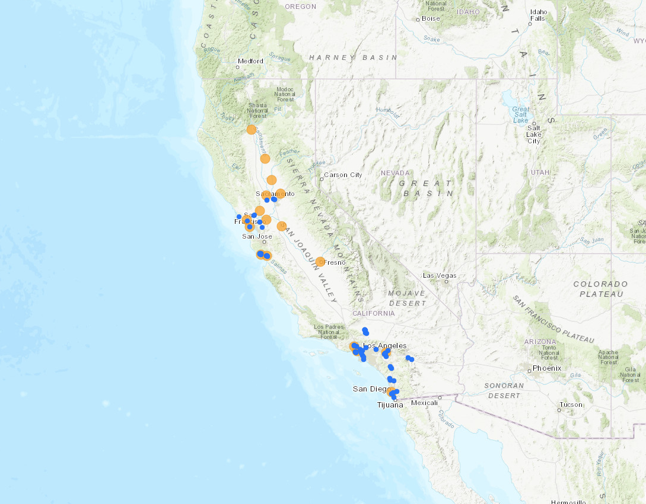
Dec 2017

Slide 10
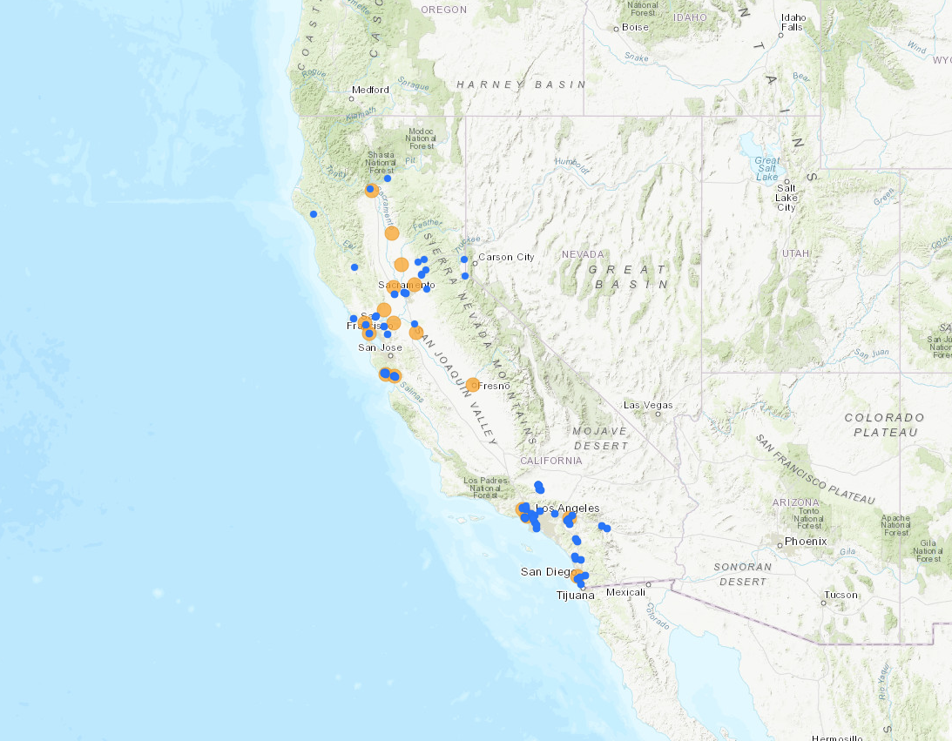
Jan 2018

Slide 11
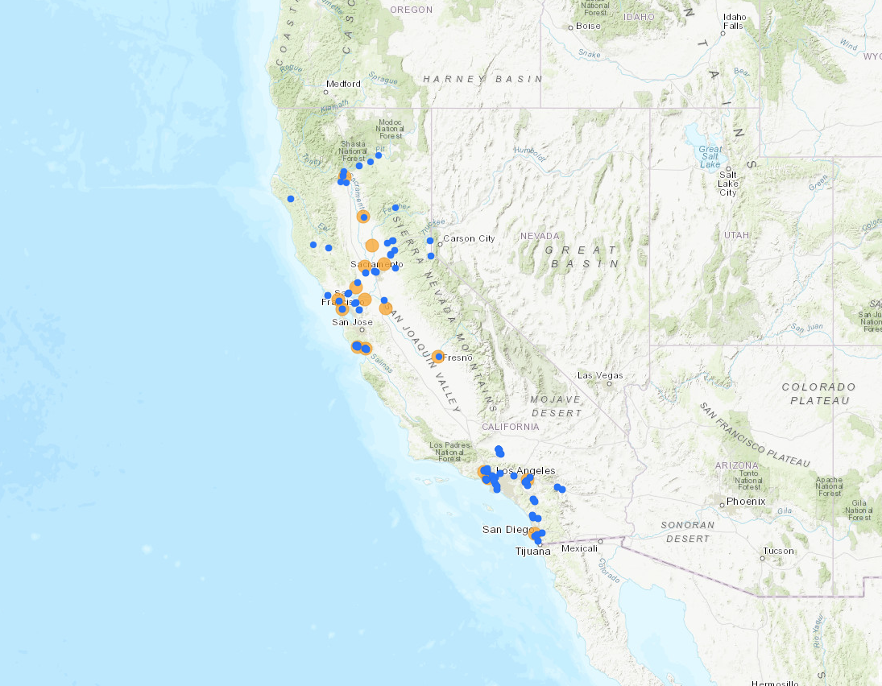
Feb 2018

Slide 12
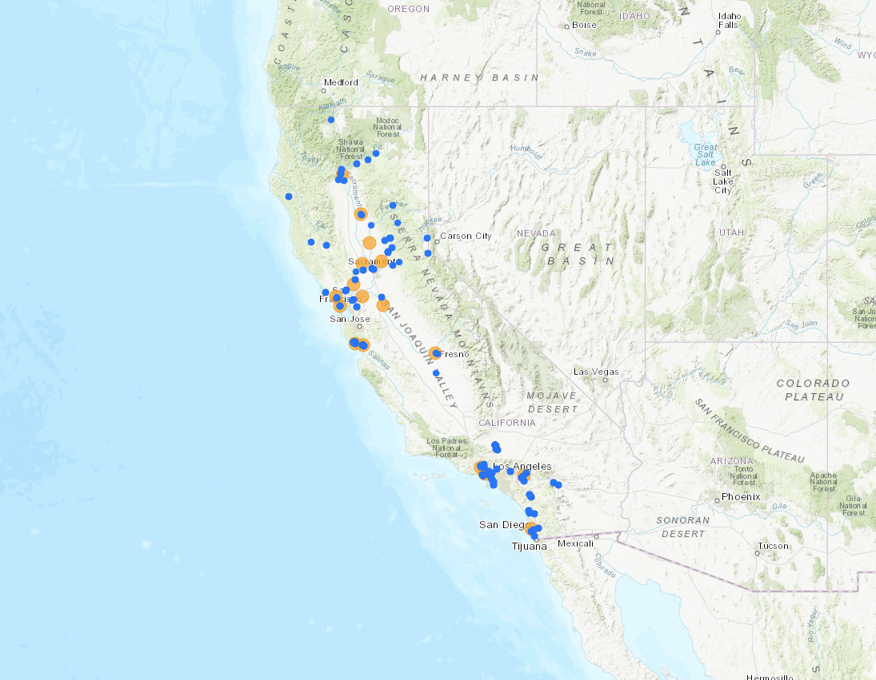
Mar 2018

Slide 13
Apr 2018

Slide 14
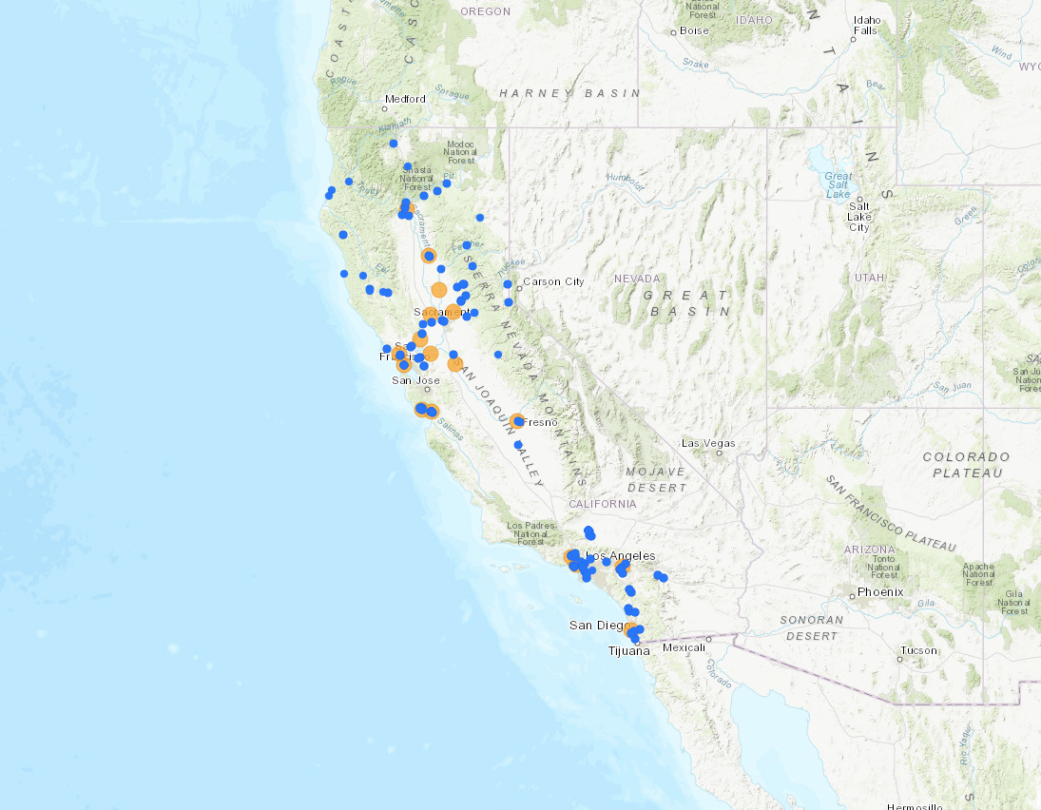
May 2018

Slide 15
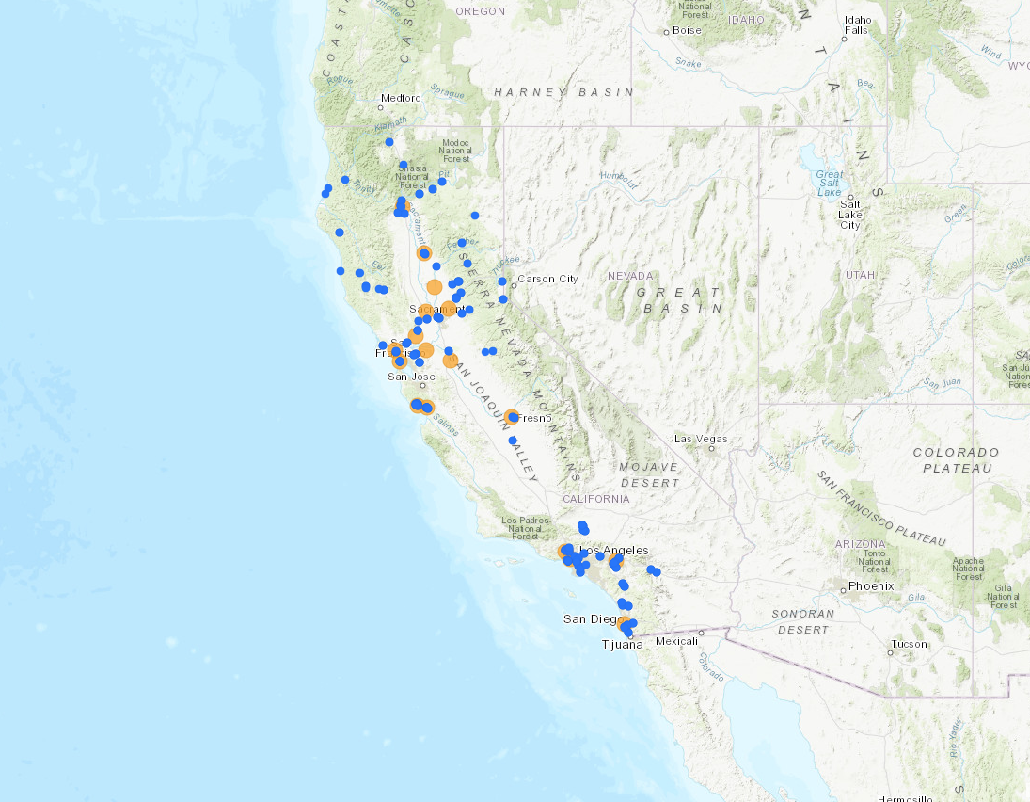
June 2018

Slide 16
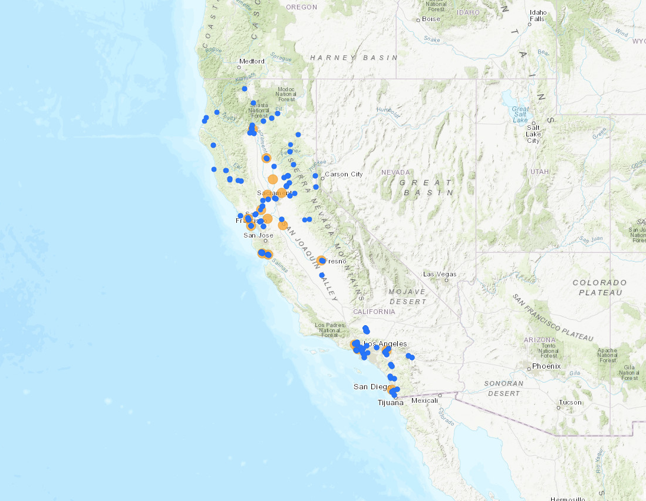
July 2018
148 Spoke Locations

Slide 17
Spoke Characteristics
95
health centers*
27
SUD treatment programs
9
behavioral
health centers
10
hospitals
3
telehealth programs
*65 health center Spoke locations are Federally Qualified Health Centers (FQHC); 5 are Indian Health Centers
Notes:
Majority of spoke treatment locations are health centers (65 are FQHCs). But 18% are SUD treatment programs

Slide 18
Hub and Spoke Patient Totals to Date* (Aug 2017 – July 2018)
N = 6,597
*Total reported to date among 17 Hubs and 110 Spokes
Notes:
Grant-period data represent the months of Aug 201 7 – July 2018. Baseline data represent the preceding 7 months (Jan – July 2017)
These data remain preliminary, as we’re still awaiting missing reports from many Spokes. 15 Spokes have yet to complete any reports. Mean imputation has been used for others who are missing any given months’ reports

Slide 19
Actively Prescribing Waivered Spoke Providers
66%
69%
65%
60%
61%
67%
51%
60%
61%
60%
59%
Notes:
Over the first year of the grant, there’s been a 54.7% increase in the number of waivered providers in the Spokes. BUT the proportion of those who actually have patients has remained pretty consistently at around 60%. Focus on gap

Slide 20
Waivered Spoke Providers
0 Patients
62% of waivered Spoke providers have 5 or fewer patients
>5 Patients
1-5 Patients
Notes:
Looking at those numbers a little more closely for the latest month (July 2018):
Among the 218 named waivered providers in the Spokes, nearly one-third have no patients, and an additional 30% are seeing only a small number (5 or fewer patients). So two-thirds of waivered providers are seeing 5 or fewer patients.
If all providers with less than 30 patients reached their waiver limits, there would be 3x the number of patients in Spokes, which is almost exactly what we need to help us reach the goal of the grant.
The average number of OUD patients that a waivered spoke provider had, as of July 2018, was 10.73 (max 147, min 0).

Slide 21
Waivered Spoke Providers
14
39%
average number of patients for H&SS providers who list themselves
5.5
average number of patients for H&SS providers who don’t
have not listed their names on the SAMHSA Physician and Treatment Locator website
(p < .005)
Notes:
Of course there are a lot of other potential reasons that new patient numbers aren’t as high as we’d like them to be. Including the possibility that those patients just aren’t walking in the door, regardless of how many providers there are. And we know this is an issue for more rural areas.
But, patients or referring clinics might also be having a hard time finding where to get treatment. 39% of waivered spoke providers aren’t currently listed on SAMSHSA’s treatment locator website.
H&SS providers who list their names on the Physician and Treatment Locator website have an average of 14 patients. Those who don’t have an average of 5.5 (p < .005). This difference remains nearly the same when excluding prescribers who have 0 patients (19 vs. 9.3; remains significant at p < .005). This may have more to do with a provider or clinic-level emphasis on outreach than just with the usefulness of the website alone. But it can’t hurt to encourage your docs to get listed, in addition to organizing other outreach efforts
This is just one small component of patient outreach

Slide 22
Provider Attitudes

Slide 23
Non-prescribing waivered providers
were less likely than those who had prescribed to agree that:
I feel confident prescribing buprenorphine
(p < .005).
I have the mentorship I need to effectively treat patients with opioid use disorders (p < .01).
Notes:
Mentorship (especially within the clinical setting) might be an issue -> provider facilitator program

Slide 24
Waivered providers in primary care
35%
agreed/strongly agreed that treating patients with OUD in primary care settings could negatively impact the workload of clinic staff
19%
agreed/strongly agreed that treating patients with OUD in primary care settings might drive away other primary care patients
Notes:
Stigma is likely also a contributing factor.
Among ALL waivered providers 35% agreed that treating patients with OUD in primary care settings could negatively impact staff workloads, and 19% agreed it could drive away other patients
Also, those working in primary care were LESS likely than those working in other settings to agree that they felt equally comfortable working with patients with OUD as they did working with other patient groups (p < .05).

Slide 25
Knowledge and Attitudes
16%
Waivered prescribers disagree/strongly disagree that
18%
MAT Team members agree/strongly agree that
I feel equally comfortable working with patients with OUD as I do working with other patient groups.
Methadone is just substituting one addiction for another.
Icon made by Freepik from www.flaticon.com
Notes:
For both of these statements, waivered docs and MAT team members working in primary care settings had worse attitudes than those working in other settings (these results were statistically significant, p < .05 for both statements). The next slide includes additional information specific to primary care.

Slide 26
Lessons Learned And Next Steps

Slide 27
Top Performing Spokes
Prioritize training and ongoing education for staff
Work on creating a multidisciplinary system of care
Have a champion
Get standard and well-defined systems in place for treatment and referrals
Notes:
In June, we did a quick survey of the top performing spokes (at that point there were 6 – which we’ll highlight on the next slide). We asked them about factors that have made their MAT implementation successful so far. These are the major themes that arose from their responses.

Slide 28
Increase Capacity of Waivered Prescribers and Multidisciplinary Teams
Training and Technical Assistance
Project ECHO, Pain and OUD, Learning Collaboratives
Expert facilitator project
Independent consultant provides onsite and tele/video conferencing with Spoke providers and teams
CSAM Medical Education Research Fellowship
Provide additional mentorship and education to prescribers

Slide 29
Combat Stigma
Public education campaigns
Webinars and other trainings
Hearing from people involved in different aspects of the treatment system (patients, nurses, prescribers)
Avoid stigmatizing language (addict, relapse, dirty vs. clean, etc.)
Dispel myths about medications

Slide 30
Provide the Least Restrictive Level of Care
Methadone→ buprenorphine→ naltrexone
One size does not fit all
Convenience for patients→ integration back into the community
Work
School
Family
Long-term costs for society

Slide 31
Supporting emergency departments
to develop and implement plans
for 24/7 access to buprenorphine
for patients with opioid use disorder
ed-bridge.org
info@ed-bridge.org
Providing clinical leaders
with the tools necessary
to start and maintain patients
on effective treatment
for opioid use disorder
projectshout.org
project.shout.coalition@gmail.com

Slide 32
www.GetSTR-TA.org

Slide 34
Panel Discussion
Joe Sepulveda, MD
Family Health Centers of San Diego
Frances Southwick, MD
CommuniCare Health Centers, Davis, CA
Alex Novek
Consumer

Slide 35
Questions and Discussion

Slide 36
Gloria Miele, Ph.D.
gmiele@mednet.ucla.edu
310-267-5888
Join our listserve! Email
kimberlyvalencia@mednet.ucla.edu

